Slide 1




Case Study
Supply and Sales Management with Business Intelligence
Submitted by : Nazrul Islam
Supervised by: Joy Dhon Chakma
Affiliation: Digital Hill Valley
Date: 31/01/2025

Slide 2
Introduction
Business Intelligence (BI) enhances decision-making in supply and sales management.
Helps optimize inventory, forecast demand, and analyze customer behavior.
Objective: Improve business performance using data-driven strategies.

Slide 3
Research Objectives
Identify key sales and supply chain trends.
Develop predictive models for sales forecasting.
Provide recommendations for inventory management and customer targeting.
Assess the impact of BI-driven strategies.

Slide 4
Methodology
Data Collection: Sales transactions, inventory levels, customer behavior,
and store performance.
Analytical Techniques:
Descriptive Analytics: Identifying trends.
Predictive Analytics: Forecasting future sales.
Prescriptive Analytics: Recommending actions.
Tools Used: Python (Pandas, Matplotlib, Scikit-learn).

Slide 5
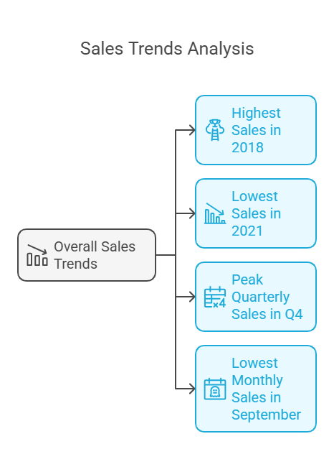
Key Findings – Sales Trends
Highest sales in 2018 (Strong business performance).
Lowest sales in 2021 (Incomplete data for the year).
Peak quarterly sales in Q4 due to holiday demand.
Lowest monthly sales in September.

Slide 6
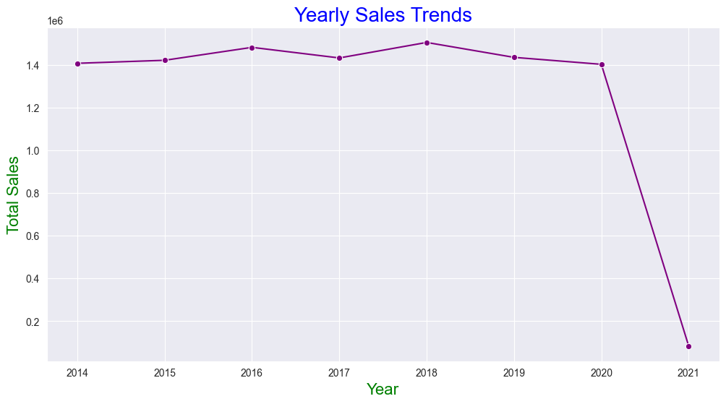
Yearly Sales Trend
1. Highest Sales in 2018: 2018 had the highest sales, showing a strong performance throughout the year.
2. Lowest Sales in 2021: 2021 has the lowest sales, but this is because only one month of sales data is available. So, the sales numbers for 2021 are not complete.

Slide 7
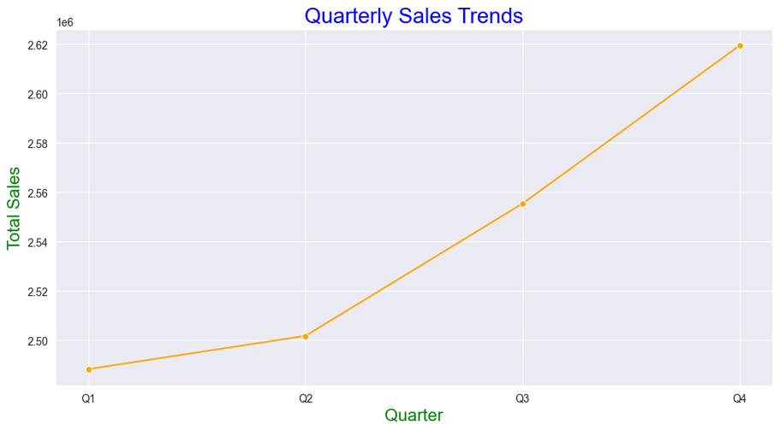
Quarterly Sales Trend
1. Highest Sales: Q4 had the highest sales, showing strong year-end performance.
2. Lowest Sales: Q1 had the lowest sales, likely due to slower activity at the year's start.
4. Overall Trend: Sales followed an upward trend throughout the year.

Slide 8
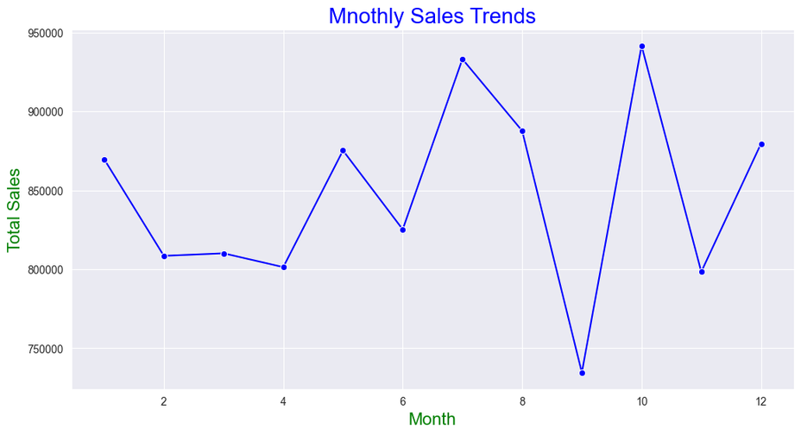
Monthly Sales Trend
1. Highest Sales Month: October had the highest sales, indicating peak performance during this month.
2. Lowest Sales Month: September had the lowest sales, possibly due to lower market demand.
3. Seasonal Trends: Sales fluctuated throughout the year, with notable increases in mid and late months (e.g., July, October).

Slide 9
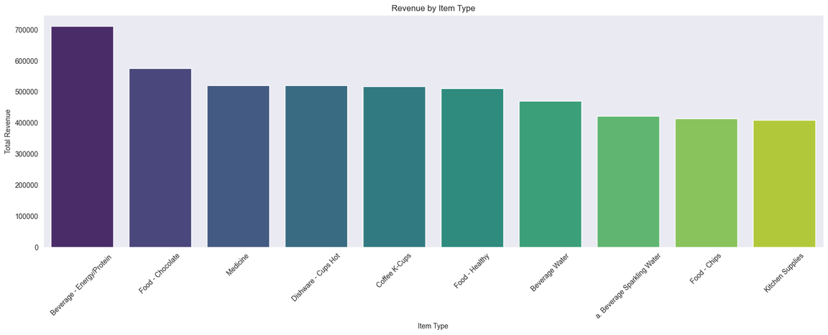
Top 10 Item Insights
Beverage - Energy/Protein drinks and Chocolate bring in the most revenue.
Most other items bring in similar amounts, while Kitchen Supplies have the lowest revenue.

Slide 10
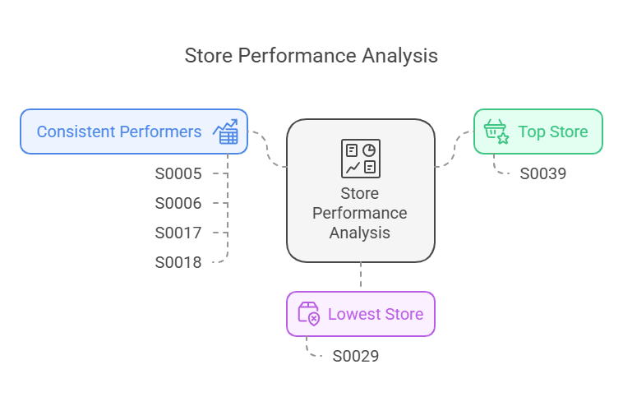
Store Performance
Top Store: S0039 (Highest revenue).
Lowest Store: S0029 (Possible location-based issues).
Consistent Performers: S0005, S0006, S0017, S0018

Slide 11
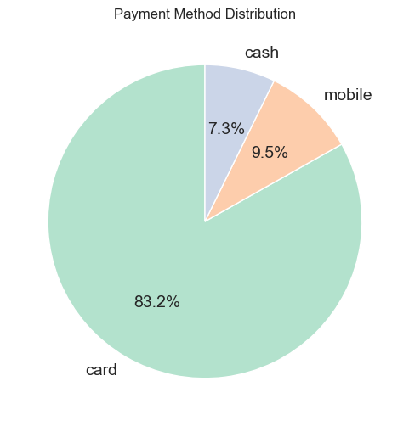
Customer Behavior Analysis
Top Customer: Pooja (Highest purchase value).
Most Popular Products: Beverages, chocolates, energy drinks.
Payment Trends:
Card Payments: 83.2%
Mobile Payments: 9.5% (Growing trend).
Cash Transactions: 7.3% (Declining).

Slide 12
Predictive & Prescriptive Analysis
Overall Dataset:
Predictive Model Accuracy: 89.7% (R² score).
Assigned Task:
Predictive Model Accuracy: 97.2% (R² score). This is excellent accuracy!
Key Variables Influencing Sales: Store location, product type, seasonality.
Recommendations:
Improve inventory planning.
Target low-demand periods with promotions.
Expand successful store locations.
Encourage digital payments.
Collaborate and Partner

Slide 13
Conclusion & Future Scope
BI improves supply chain and sales efficiency.
Helps businesses make data-driven decisions.
Future research:
AI-powered real-time analytics.
Deep learning for advanced forecasting.
Geospatial analysis for store performance.

Slide 14


